Slide 1



Summer Internship Program
IISER Bhopal
Quantum Dense Coding Using Bipartite and Multipartite Entangled States Over Noiseless and Noisy Quantum Channels: An IBM Quantum Experience
Submitted by
Rangan Chakrabarty
UG-IV, Department of Physics,
Jadavpur University, Kolkata-700032, India
Under the Supervision of
Supervisor: Prof. Kuntal Roy
Department of Electrical Engineering And Computer Science
Indian Institute of Science Education and Research (IISER) Bhopal,
Bhopal-462066, India

Slide 2

Objectives
To investigate quantum dense coding (QDC) protocols using different entangled quantum states for classical information transmission.
To perform a comparative analysis of dense coding protocols employing various multipartite entangled channels.
To analyze the theoretical performance of the considered protocols under ideal (noise-free) quantum communication environments.
To evaluate key performance metrics, including communication capacity, state fidelity, circuit depth, quantum cost, and gate complexity.
To investigate the robustness of different QDC protocols under realistic Pauli noise models, including bit-flip, phase-flip, and bit-phase-flip channels.
To compare the strengths and limitations of different entangled channels based on their communication efficiency, robustness against noise, and implementation complexity.
To validate the analytical results through Qiskit-based simulations and verify the agreement between theoretical predictions and simulation outcomes.
To study the impact of circuit depth and gate complexity on the practical performance of quantum dense coding protocols.
©Rangan Chakrabarty, Jadavpur University, 2026

Slide 3
Chapter-I
Background & Preliminaries
©Rangan Chakrabarty, Jadavpur University, 2026

Slide 4
Background & Preliminaries
Entanglement and it’s classification
Entangled quantum channels
Density matrix formalism
Performance metrics for quantum dense coding
Dense coding capacity
Schmidt Decomposition
Holevo bound
Output state fidelity
Channel efficiency
Robustness of the protocol
Quantum circuit depth
Quantum Bit Error Rate (QBER)
Quantum resource cost
Density matrix
Partial trace
Reduced density matrix
Noisy quantum channels
Bit flip channel
Phase flip channel
Bit-phase flip channel
©Rangan Chakrabarty, Jadavpur University, 2026

Slide 5
Chapter-II
Quantum dense coding protocols in noiseless environment
©Rangan Chakrabarty, Jadavpur University, 2026

Slide 6



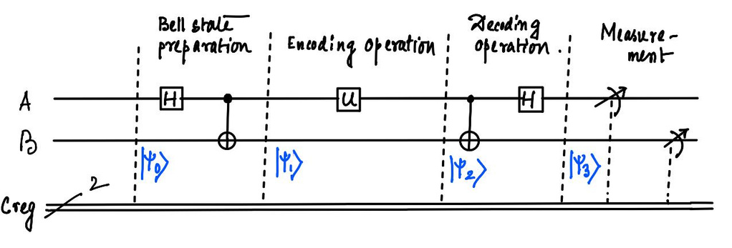
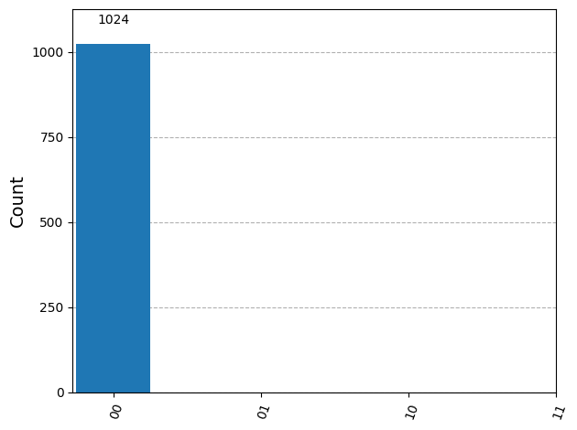
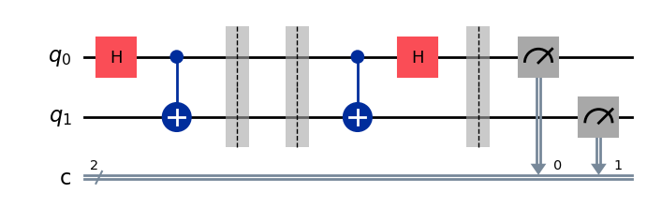
Quantum dense coding protocols in noiseless environment
Standard QDC using Bell state
Preparation of Bell state
Encoding operation of Alice
Bob’s decoding operation
Quantum Dense coding circuit using Bell state
Output of Quantum Dense coding circuit using Bell state
©Rangan Chakrabarty, Jadavpur University, 2026

Slide 7
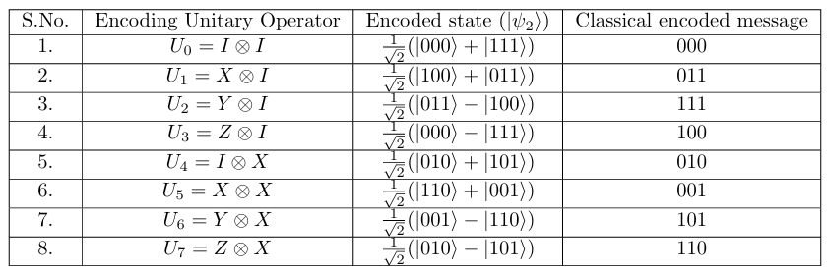
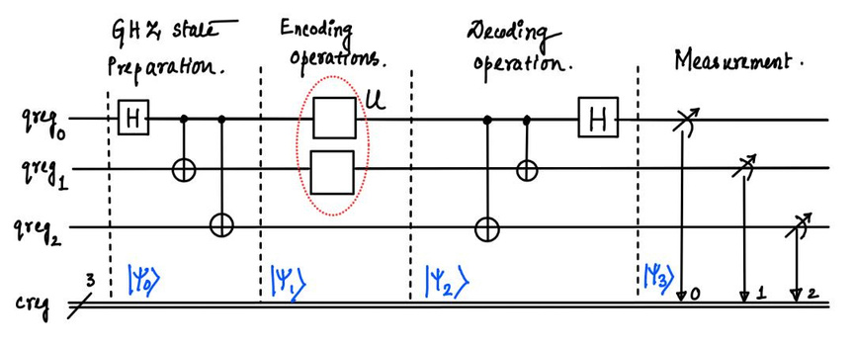
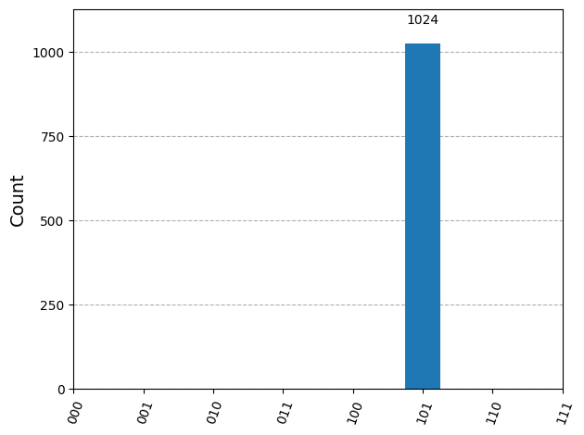
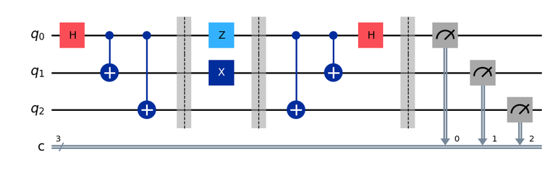
Quantum dense coding protocols in noiseless environment
Standard QDC using 3 qubit GHZ state
Preparation of 3 qubit GHZ state
Encoding operation of Alice
Bob’s decoding operation
Quantum Dense coding circuit using 3 qubit GHZ state
Output of Quantum Dense coding circuit using 3 qubit GHZ state
©Rangan Chakrabarty, Jadavpur University, 2026

Slide 8
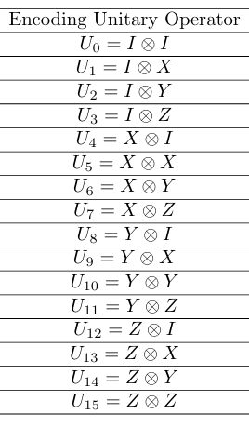
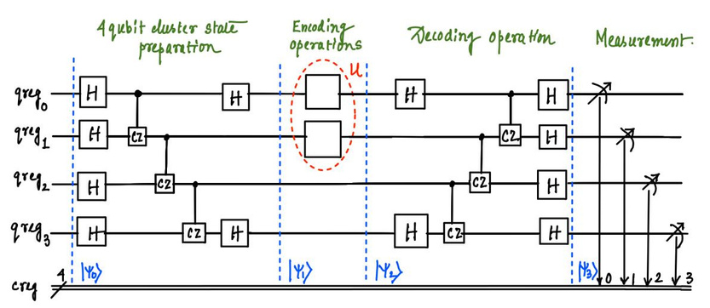
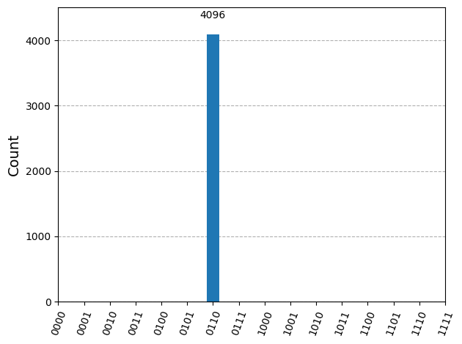
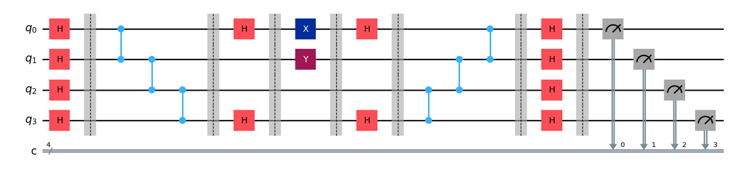
Quantum dense coding protocols in noiseless environment
Standard QDC using 4 qubit cluster state
Preparation of 4 qubit cluster state
Encoding operation of Alice
Bob’s decoding operation
Quantum Dense coding circuit using 4 qubit cluster state
Output of Quantum Dense coding circuit using 4 qubit GHZ state
©Rangan Chakrabarty, Jadavpur University, 2026

Slide 9
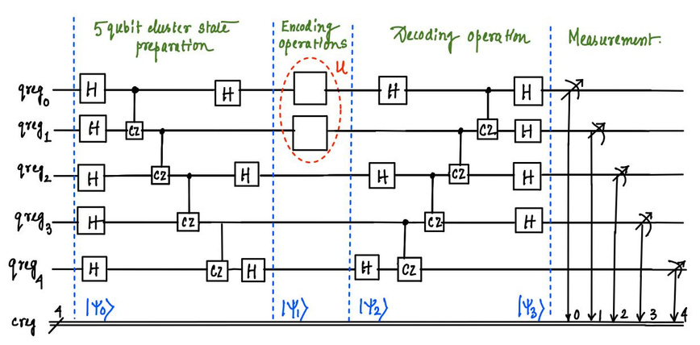
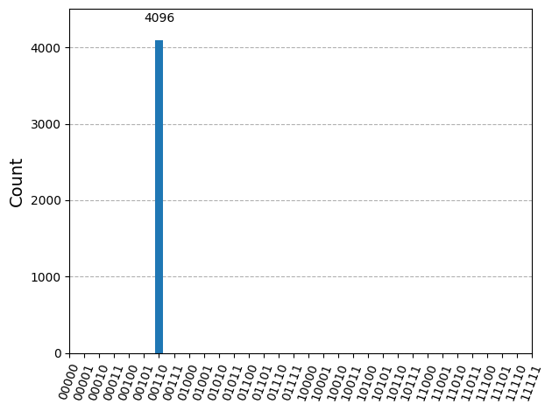
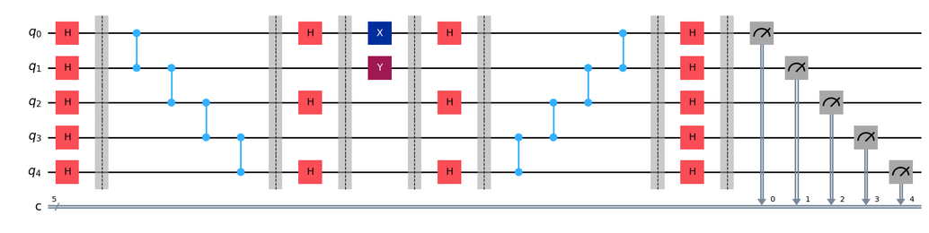
Quantum dense coding protocols in noiseless environment
Standard QDC using 5 qubit cluster state
Preparation of 5 qubit cluster state
Encoding operation of Alice
Bob’s decoding operation
Total 16 orthogonal encoding unitary operators are present
(Ref Sec 3.4.3 in the report)
Quantum Dense coding circuit using 5 qubit cluster state
Output of Quantum Dense coding circuit using 5 qubit cluster state
©Rangan Chakrabarty, Jadavpur University, 2026

Slide 10
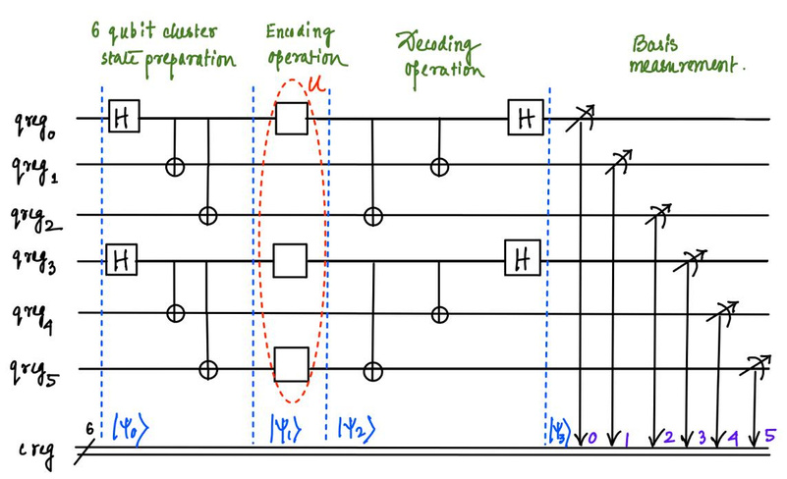
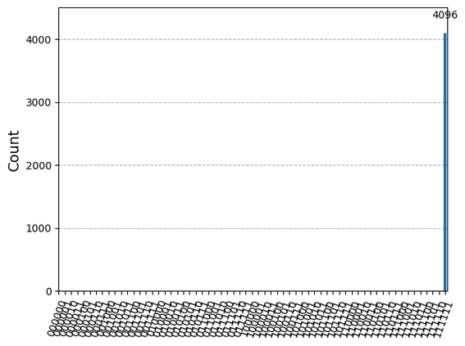
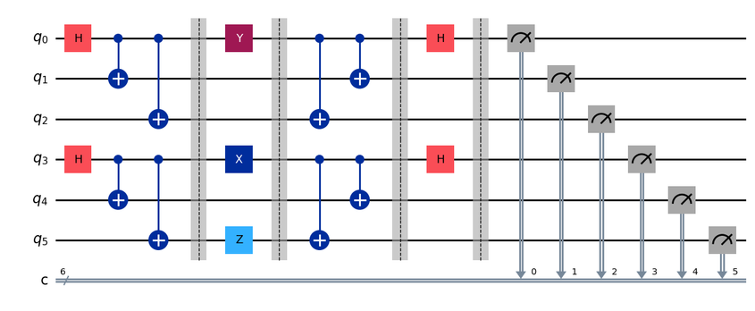
Quantum dense coding protocols in noiseless environment
Standard QDC using 6 qubit cluster state
Preparation of 6 qubit cluster state
Encoding operation of Alice
Bob’s decoding operation
Total 32 orthogonal, distinguishable encoding unitary operators are present
(Ref Sec 3.5.3 in the report)
Quantum Dense coding circuit using 6 qubit cluster state
Output of Quantum Dense coding circuit using 6 qubit cluster state
©Rangan Chakrabarty, Jadavpur University, 2026

Slide 11
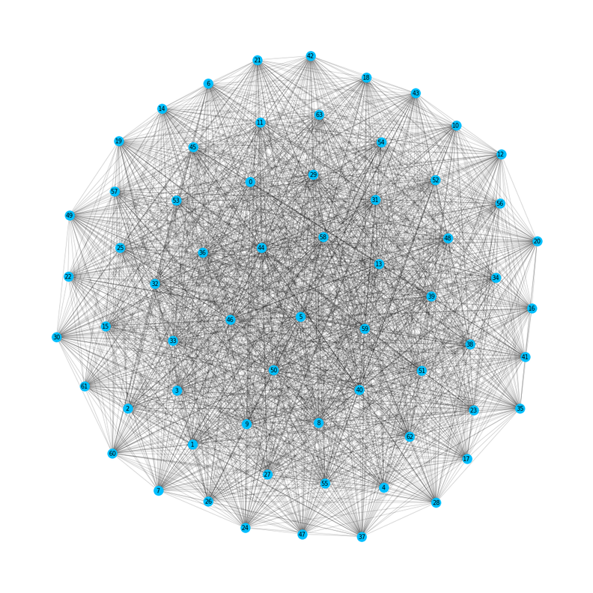
Quantum dense coding protocols in noiseless environment
Standard QDC using 6 qubit cluster state
Preparation of 6 qubit cluster state
Encoding operation of Alice
Bob’s decoding operation
Visualization of total 64 encoded cluster states where all encoded states are not perfectly distinguishable by Bob
©Rangan Chakrabarty, Jadavpur University, 2026

Slide 12
Chapter-III
Quantum dense coding protocols in noisy environment
©Rangan Chakrabarty, Jadavpur University, 2026

Slide 13
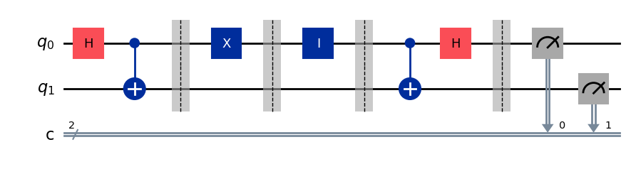


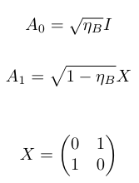
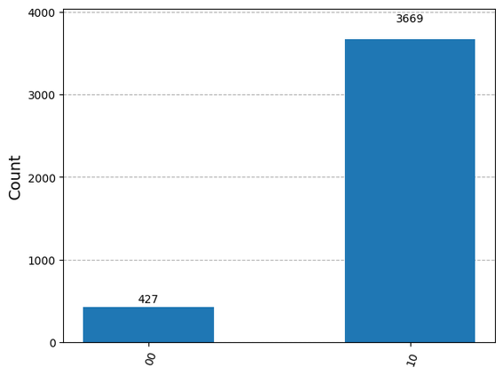
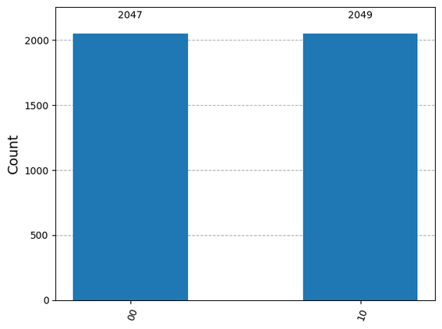
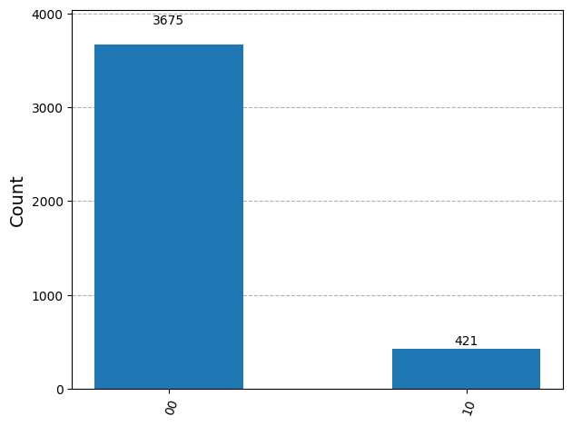

Quantum dense coding protocols in noisy environment
QDC over bit flip channel- QDC Protocol using Bell state
Preparation of Bell state
Encoding operation of Alice
Bob’s decoding operation
Bit flip channel
Quantum circuit for dense coding using Bell state with bit flip noise
State fidelity
Output fidelity when noise parameter is 0.1, 0.5, 0.9 respectively
©Rangan Chakrabarty, Jadavpur University, 2026

Slide 14
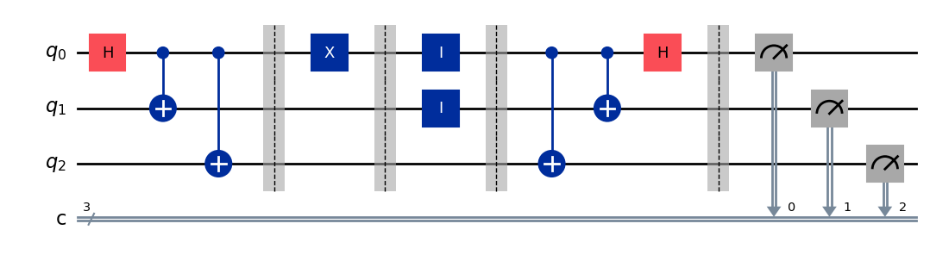
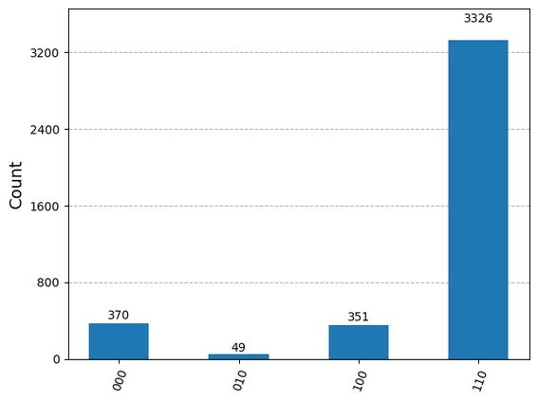
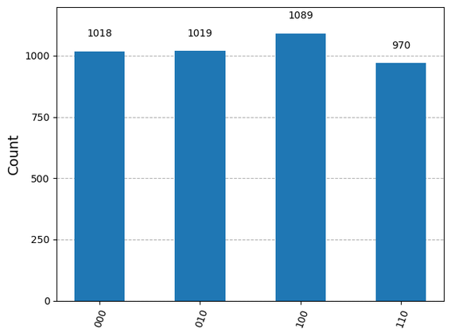
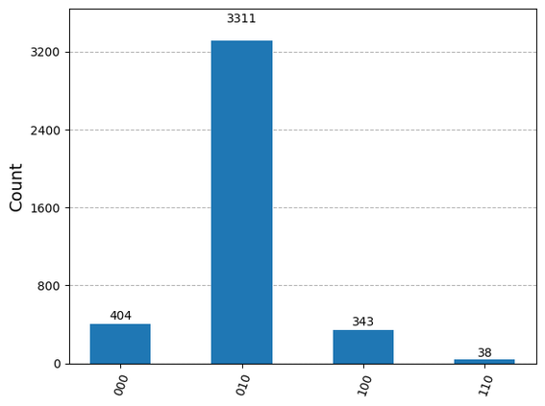
Quantum dense coding protocols in noisy environment
QDC over bit flip channel- QDC Protocol using 3 qubit GHZ state
Preparation of 3 qubit GHZ channel
Encoding operation of Alice
Bob’s decoding operation
Bit flip channel
Quantum circuit for dense coding using 3 qubit GHZ state with bit flip noise
State fidelity
Output fidelity when noise parameter is 0.1, 0.5, 0.9 respectively
©Rangan Chakrabarty, Jadavpur University, 2026

Slide 15
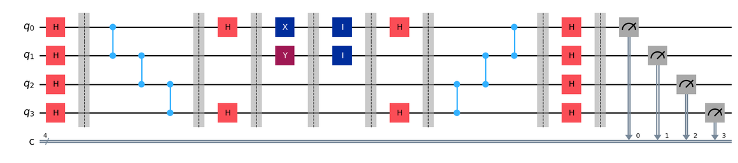
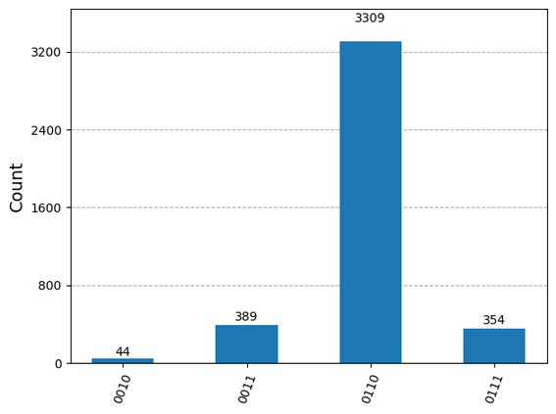
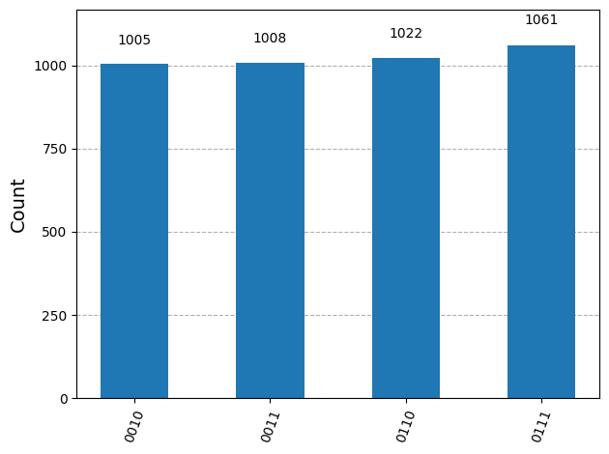
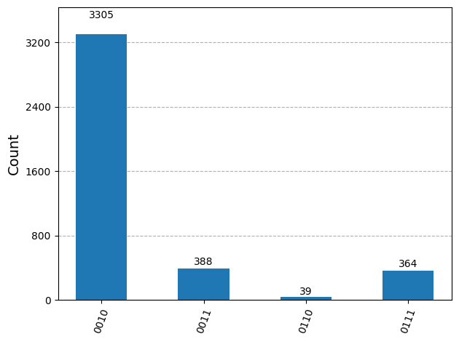
Quantum dense coding protocols in noisy environment
QDC over bit flip channel- QDC Protocol using 4 qubit cluster state
Preparation of 4 qubit cluster channel
Encoding operation of Alice
Bob’s decoding operation
Bit flip channel
Quantum circuit for dense coding using 4 qubit cluster with bit flip noise
State fidelity
Output fidelity when noise parameter is 0.1, 0.5, 0.9 respectively
©Rangan Chakrabarty, Jadavpur University, 2026

Slide 16
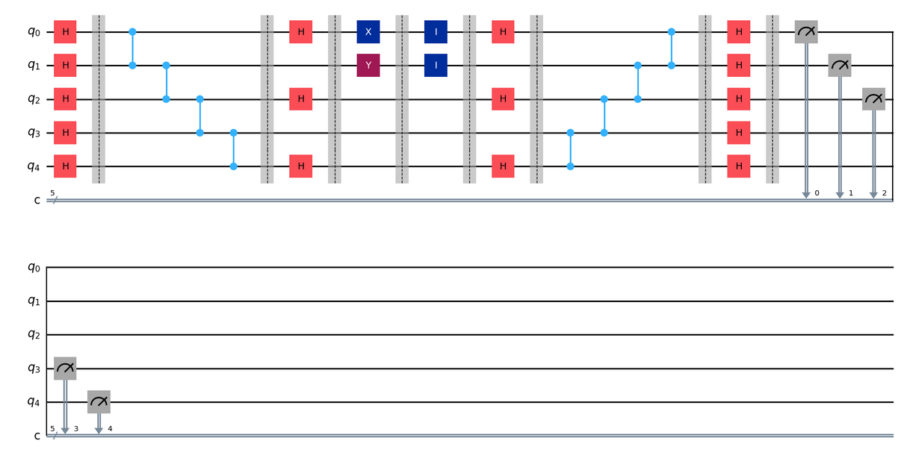
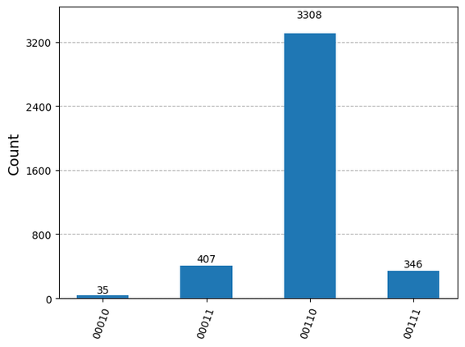
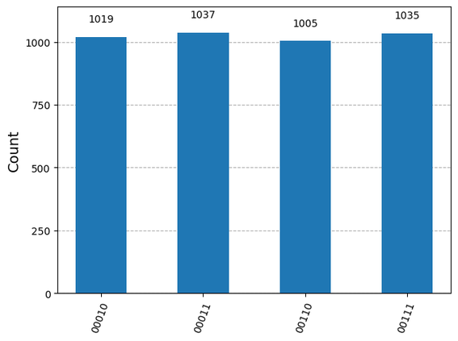
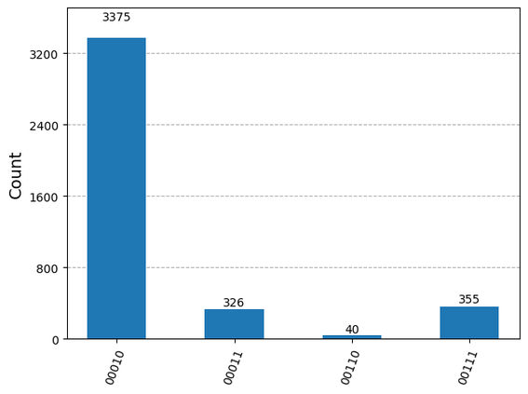
Quantum dense coding protocols in noisy environment
QDC over bit flip channel- QDC Protocol using 5 qubit cluster state
Preparation of 5 qubit cluster channel
Encoding operation of Alice
Bob’s decoding operation
Bit flip channel
Quantum circuit for dense coding using 5 qubit cluster with bit flip noise
State fidelity
Output fidelity when noise parameter is 0.1, 0.5, 0.9 respectively
©Rangan Chakrabarty, Jadavpur University, 2026

Slide 17
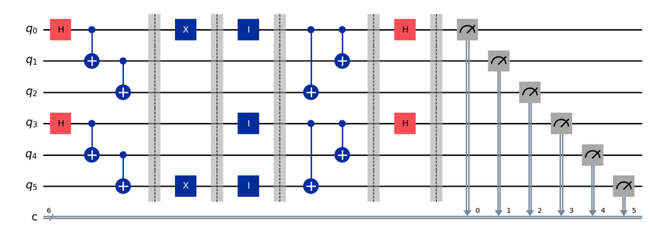
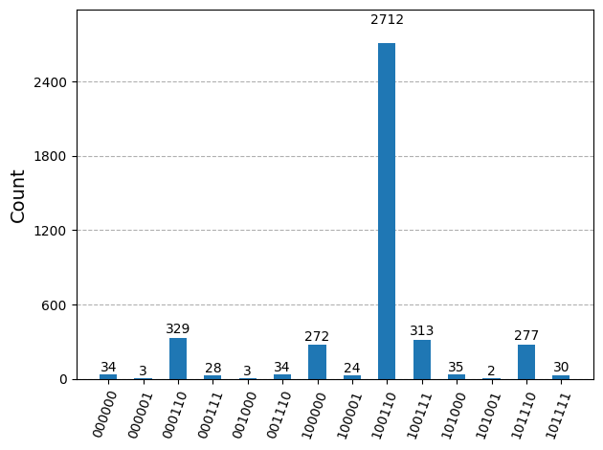
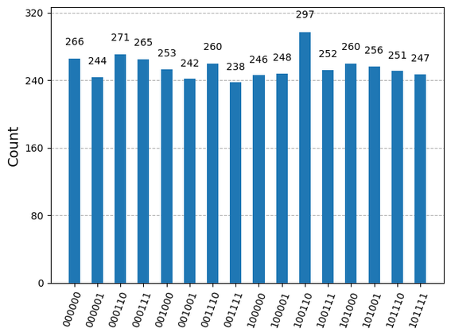
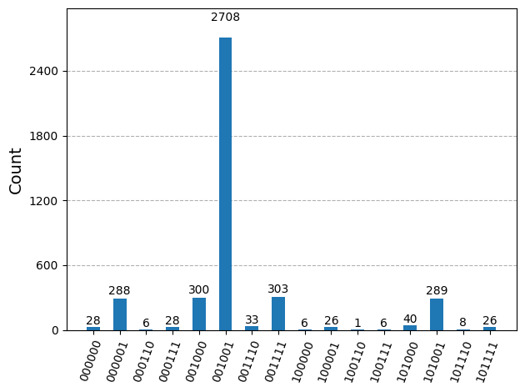
Quantum dense coding protocols in noisy environment
QDC over bit flip channel- QDC Protocol using 6 qubit cluster state
Preparation of 6 qubit cluster channel
Encoding operation of Alice
Bob’s decoding operation
Bit flip channel
Quantum circuit for dense coding using 6 qubit cluster with bit flip noise
State fidelity
Output fidelity when noise parameter is 0.1, 0.5, 0.9 respectively
©Rangan Chakrabarty, Jadavpur University, 2026

Slide 18
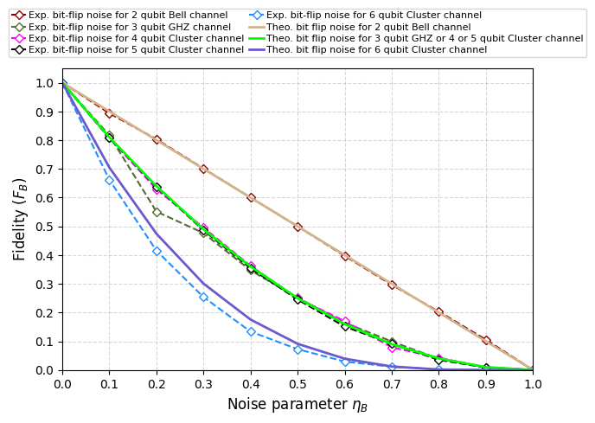
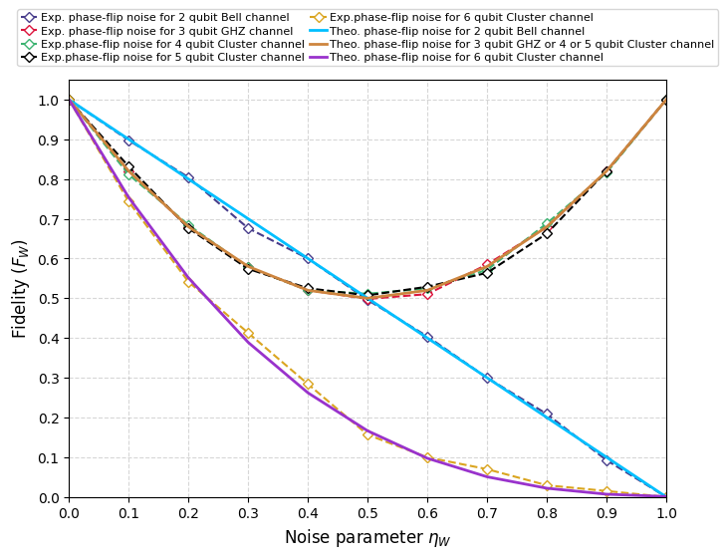
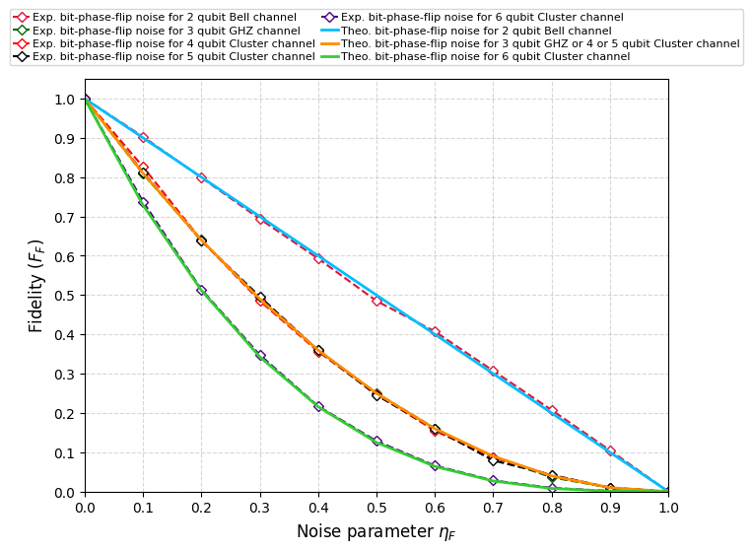
Quantum dense coding protocols in noisy environment
QDC over noisy channel
Preparation of different entangled channel
Encoding operation of Alice
Bob’s decoding operation
The same protocols are again implemented for Phase flip noise model and Bit-phase flip noise model
And the output fidelity is observed. (ref. Sec. 4.2 and 4.3 of report)
Fidelity vs noise parameter graph for different entangled channel dense coding protocols for respectively bit flip, phase flip and bit-phase flip noise models
©Rangan Chakrabarty, Jadavpur University, 2026

Slide 19
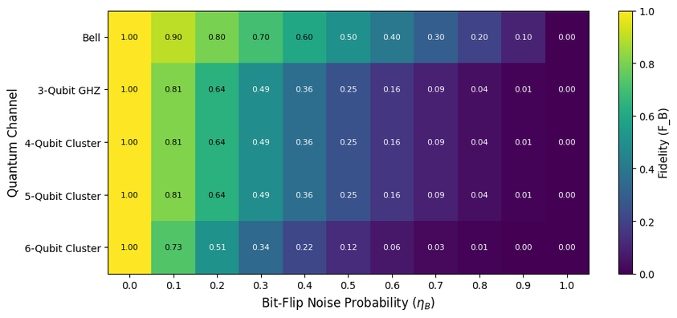
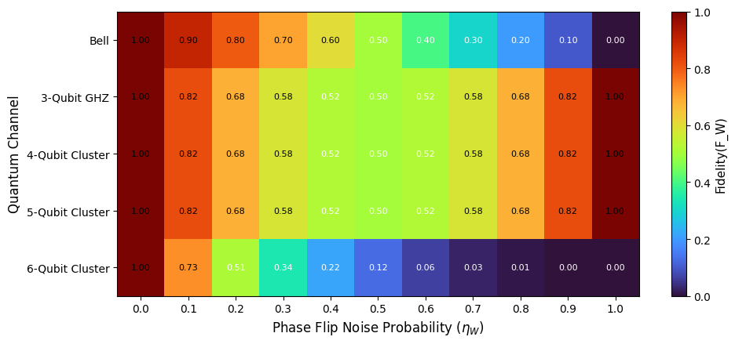
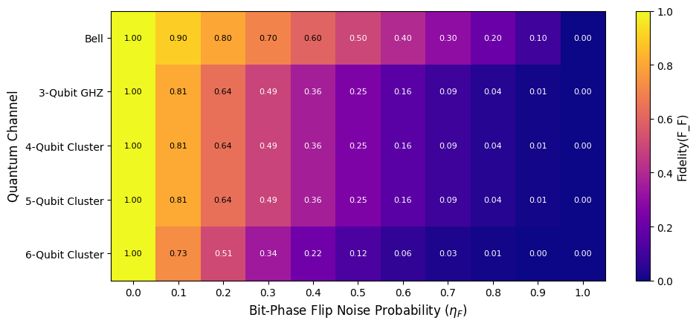
Quantum dense coding protocols in noisy environment
QDC over noisy channel
Preparation of different entangled channel
Encoding operation of Alice
Bob’s decoding operation
Heatmap representation of Fidelity vs noise parameter graph for different entangled channel dense coding protocols for respectively bit flip, phase flip and bit-phase flip noise models
©Rangan Chakrabarty, Jadavpur University, 2026

Slide 20
Chapter-IV
Analysis of different performance metrics
©Rangan Chakrabarty, Jadavpur University, 2026

Slide 21
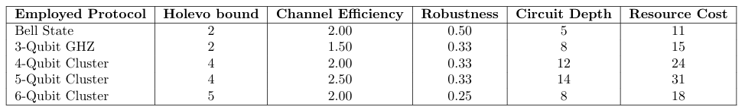
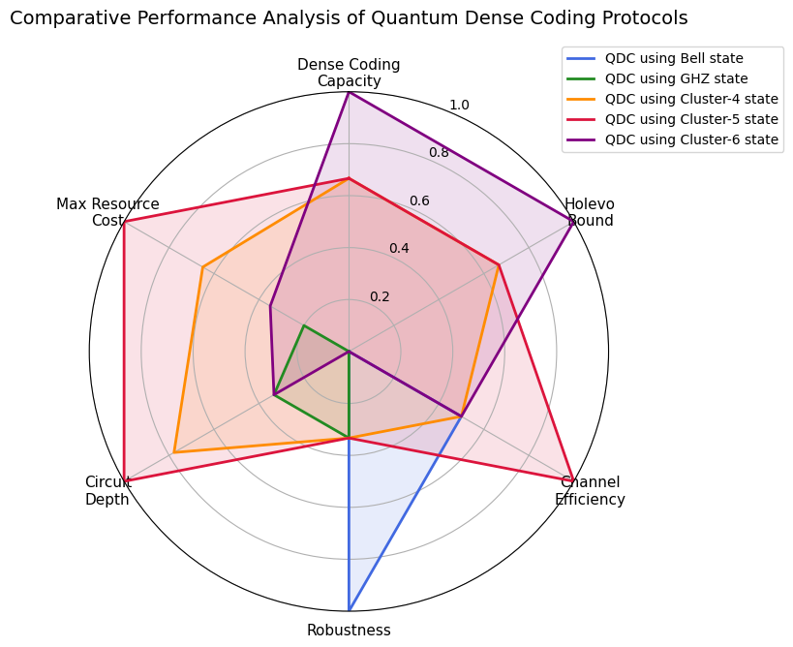
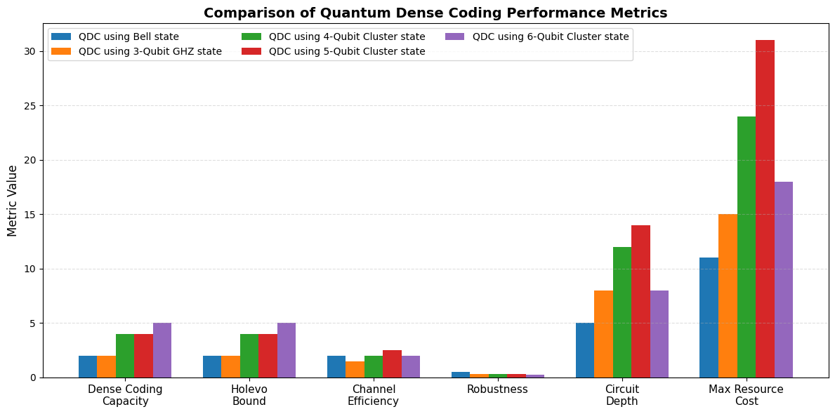
Analysis of different performance metrics
©Rangan Chakrabarty, Jadavpur University, 2026

Slide 22
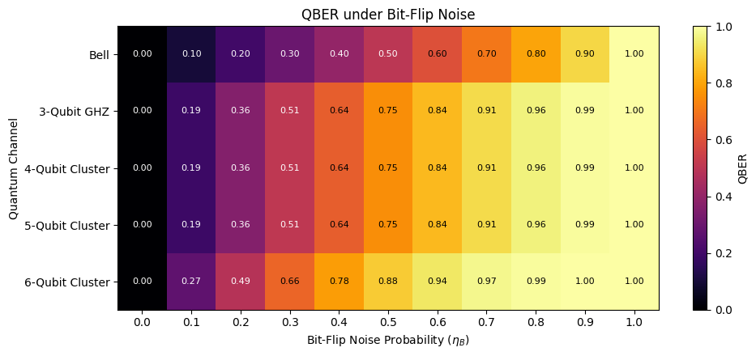
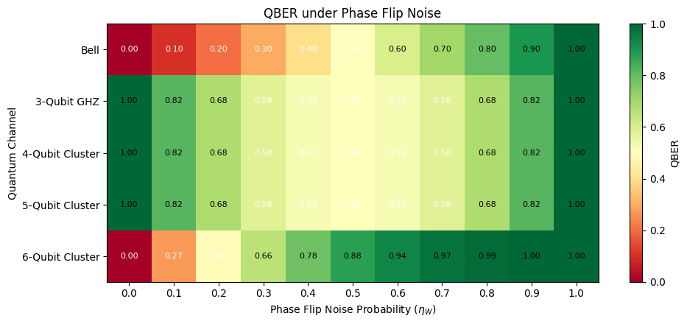

Analysis of different performance metrics
QBER performance for respectively bit flip, phase flip and bit phase flip noise in quantum dense coding using different entangled states
©Rangan Chakrabarty, Jadavpur University, 2026

Slide 23
Discussions & Conclusion
Found that protocols with higher communication capacity require deeper quantum circuits and a larger number of quantum gates.
Confirmed excellent agreement between analytical derivations and simulation results for all dense coding protocols studied.
Established that maximally entangled quantum states provide a reliable and deterministic resource for quantum dense coding.
Evaluated the performance of different QDC protocols under bit-flip, phase-flip, and bit-phase-flip noisy quantum channels.
Showed that the Bell-state QDC protocol exhibits the highest state fidelity under bit-flip and bit-phase-flip noise models.
Found that the three-qubit GHZ-state and four- and five-qubit cluster-state protocols demonstrate superior performance under the phase-flip noise model.
Observed that increasing circuit depth makes dense coding protocols more vulnerable to hardware-induced noise in practical quantum processors.
Identified that the Bell-state QDC circuit possesses the shallowest circuit depth, whereas cluster-state protocols generally require deeper quantum circuits.
Demonstrated that the quantum cost increases with both the number of qubits and the gate complexity of the protocol.
©Rangan Chakrabarty, Jadavpur University, 2026

Slide 24
Future scopes
Investigate the performance of quantum dense coding protocols under additional noise models, such as amplitude damping, phase damping, and depolarizing channels.
Explore dense coding protocols using other multipartite entangled states, including Brown et al. states, Borrás et al. states, graph states, Dicke states, and hypergraph states.
Develop dense coding protocols with reduced gate complexity while maintaining deterministic information transmission to improve robustness against noise.
Incorporate quantum error correction (QEC) and quantum error mitigation (QEM) techniques to enhance transmission reliability and reduce errors.
Extend existing protocols to large-scale quantum communication networks for practical distributed quantum communication.
Investigate higher-dimensional (qudit-based) dense coding protocols to achieve improved communication capacity and resource efficiency.
Evaluate the practical feasibility of these protocols on near-term and future quantum hardware, considering realistic device constraints.
Design more noise-resilient and hardware-efficient dense coding schemes suitable for scalable quantum communication applications.
©Rangan Chakrabarty, Jadavpur University, 2026

Slide 25
References
[1] M. A. Nielsen and I. L. Chuang, Quantum Computation and Quantum Information. Cambridge University Press, 2010.
[2] A. Pathak, Elements of Quantum Computation and Quantum Communication. CRC Press, Boca Raton, FL, 2013.
[3] C. H. Bennett and S. J. Wiesner, "Communication via One- and Two-Particle Operators on Einstein-Podolsky-Rosen States," Physical Review Letters, vol. 69, no. 20, pp. 2881–2884, 1992.
[4] A. K. Ekert, "Quantum Cryptography Based on Bell's Theorem," Physical Review Letters, vol. 67, no. 6, pp. 661–663, 1991.
[5] C. H. Bennett and S. J. Wiesner, "Dense Coding via Quantum Entanglement," Physical Review Letters, vol. 69, p. 2881, 1992. (Duplicate of [3])
[6] C. H. Bennett, G. Brassard, C. Crépeau, R. Jozsa, A. Peres, and W. K. Wootters, "Teleporting an Unknown Quantum State via Dual Classical and Einstein-Podolsky-Rosen Channels," Physical Review Letters, vol. 70, pp. 1895–1899, 1993.
[7] C. H. Bennett and A. K. Ekert, "Dense Coding Based on Quantum Entanglement," Department of Physics, University of Oxford, 1994.
[8] R. Horodecki, P. Horodecki, M. Horodecki, and K. Horodecki, "Quantum Entanglement," Reviews of Modern Physics, vol. 81, pp. 865–942, 2009.
[9] S. Das, T. Chanda, M. Lewenstein, A. Sanpera, A. Sen(De), and U. Sen, "The Separability versus Entanglement Problem," arXiv preprint, 2017.
[10] C. H. Bennett and S. J. Wiesner, "Communication via One- and Two-Particle Operators on Einstein-Podolsky-Rosen States," Physical Review Letters, vol. 69, pp. 2881–2884, 1992. (Duplicate of [3])
[11] M. A. Nielsen and I. L. Chuang, Quantum Computation and Quantum Information. Cambridge University Press, Cambridge, UK, 2010. (Duplicate of [1])
[12] X. Tan, X. Li, and P. Yang, "Perfect Quantum Teleportation via Bell States," Computers, Materials & Continua, vol. 57, no. 3, pp. 495–503, 2018.
[13] S. Ghosh, G. Kar, A. Roy, D. Sarkar, and U. Sen, "Entanglement Teleportation through GHZ-Class States," New Journal of Physics, vol. 4, pp. 48.1–48.9, 2002.
[14] J. Joo, Y.-J. Park, S. Oh, and J. Kim, "Quantum Teleportation via a W State," New Journal of Physics, vol. 5, p. 136, 2003.
[15] A. Pandey, "Quantum Teleportation Using W-Bell and Bell-GHZ Channels," International Journal of Engineering, Science and Mathematics, vol. 13, Aug. 2024.
©Rangan Chakrabarty, Jadavpur University, 2026

Slide 26
References
[16] M. Anagha, A. Mohan, T. Muruganandan, B. K. Behera, and P. K. Panigrahi, "A New Scheme of Quantum Teleportation Using Highly Entangled Brown et al. State: An IBM Quantum Experience," Quantum Information Processing, vol. 19, p. 147, 2020.
[17] D. Singh, S. Kumar, and B. K. Behera, "Complexity Analysis of Quantum Teleportation via Different Entangled Channels in the Presence of Noise," IET Quantum Communication, vol. 3, no. 4, pp. 166–176, 2022.
[18] M. Sisodia, A. Shukla, K. Thapliyal, and A. Pathak, "Design and Experimental Realization of an Optimal Scheme for Teleportation of an n-Qubit Quantum State," arXiv preprint, 2017.
[19] A. S. Cacciapuoti, M. Caleffi, R. Van Meter, and L. Hanzo, "When Entanglement Meets Classical Communications: Quantum Teleportation for the Quantum Internet," IEEE Transactions on Communications, vol. 68, no. 6, pp. 3808–3833, 2020.
[20] H.-J. Briegel, W. Dür, J. I. Cirac, and P. Zoller, "Quantum Repeaters: The Role of Imperfect Local Operations in Quantum Communication," Physical Review Letters, vol. 81, no. 26, pp. 5932–5935, 1998.
[21] K. Mattle, H. Weinfurter, P. G. Kwiat, and A. Zeilinger, "Dense Coding in Experimental Quantum Communication," Physical Review Letters, vol. 76, pp. 4656–4659, 1996.
[22] S. Bose, V. Vedral, and P. L. Knight, "Multiparticle Generalization of Quantum Dense Coding," Physical Review A, vol. 57, pp. 822–829, 1998.
[23] J.-C. Hao et al., "Controlled Dense Coding Using a Four-Particle GHZ State," Physical Review A, vol. 63, p. 054301, 2001.
[24] S. Muralidharan and P. K. Panigrahi, "Perfect Teleportation, Quantum State Sharing and Superdense Coding Through a Genuinely Entangled Five-Qubit State," Physical Review A, vol. 77, no. 3, p. 032321, 2008.
[25] D. Saha and P. K. Panigrahi, "N-Qubit Quantum Teleportation, Information Splitting and Superdense Coding Through the Composite GHZ-Bell Channel," arXiv preprint, 2011.
[26] H.-J. Briegel and R. Raussendorf, "Persistent Entanglement in Arrays of Interacting Particles," Physical Review Letters, vol. 86, pp. 910–913, 2001.
[27] R. Raussendorf and H.-J. Briegel, "A One-Way Quantum Computer," Physical Review Letters, vol. 86, pp. 5188–5191, 2001.
[28] J. Preskill, Quantum Computing Lecture Notes, 2018.
[29] IBM Quantum, "Qiskit Documentation," 2023. https://qiskit.org
©Rangan Chakrabarty, Jadavpur University, 2026

Slide 27
THANK YOU

